Slide 1
Unit 2 Supervised Learning I- Linear regression- I
Simple Linear Regression
Multiple Linear Regression
Polynomial Regression
Ridge Regression
Lasso Regression

Slide 2
What is data modeling/model building : Use a suitable machine learning algorithm to build model
steps involved in training or building a model are :
Select suitable model technique (data mining technique)
Select the suitable algorithm
check accuracy of the model created using chosen algorithm
Compare accuracy of the models generated by different algorithms

Slide 3
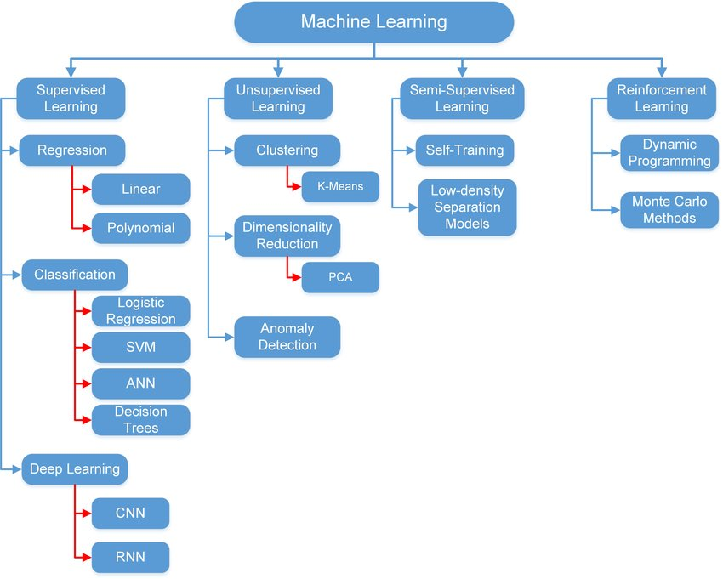

Slide 4
Supervised Machine Learning
Supervised Machine Learning
Regression
Classification
Simple Linear
Logistic Regression
Multiple Linear
Decision Tree Regression
Polynomial
Random Forest
Ridge Regression
Support Vector Machine
Lasso Regression

Slide 5
Regression
Regression is a method of modeling a target value based on independent predictors.
This method is mostly used for forecasting and finding out cause and effect relationship between variables.
Regression techniques mostly differ based on the number of independent variables and the type of relationship between the independent and dependent variables.

Slide 6
Independent variable
Independent variables are the ones that you include in the model to explain or predict changes in the dependent variable.
Independent variables are also known as predictors
On graphs, analysts place independent variables on the horizontal, or X, axis.
In machine learning, independent variables are known as features.
For example, in a politicians strength study, the independent variables
might be political party (categorical) and gender of politician(categorical)
For example, in a plant growth study, the independent variables might be soil moisture (continuous) and type of fertilizer (categorical).

Slide 7
Independent variable
Independent variables are the ones that you include in the model to explain or predict changes in the dependent variable.
Independent variables are also known as predictors
On graphs, analysts place independent variables on the horizontal, or X, axis.
In machine learning, independent variables are known as features.
For example, in a politicians strength study, the independent variables
might be political party (categorical) and gender of politician(categorical)
For example, in a plant growth study, the independent variables might be soil moisture (continuous) and type of fertilizer (categorical).

Slide 8
dependent variable
The dependent variable (DV) is what you want to use the model to explain or predict.
dependent variables are also known as response variable
On graphs, analysts place dependent variable on the vertical, or Y, axis.
For example, in a politicians strength (dependent variable) study, the independent variables might be political party (categorical) and gender of politician(categorical)
For example, in a plant growth (dependent variable)study, the independent variables might be soil moisture (continuous) and type of fertilizer (categorical).

Slide 9
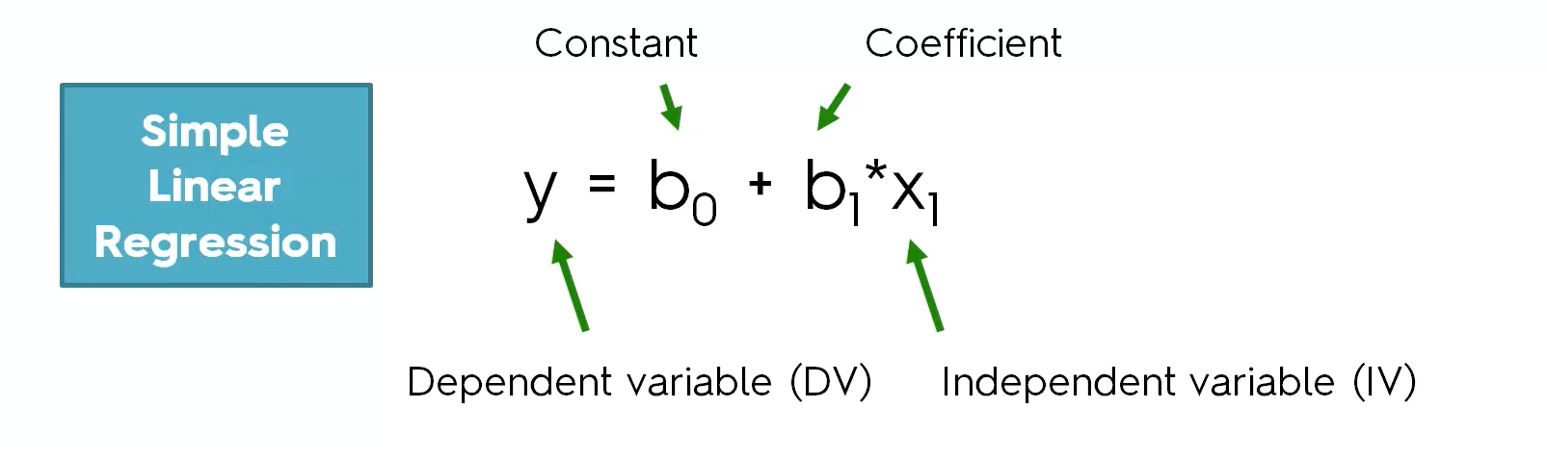
Simple Linear regression
Straight line regression analysis involves a response variable y and a single predictor variable x and models y is a linear function of x
where b0 (y-intercept) and b1 (slope) are regression coefficients
These coefficients can be solved by the method of least squares which estimates the best fitting straight line

Slide 10
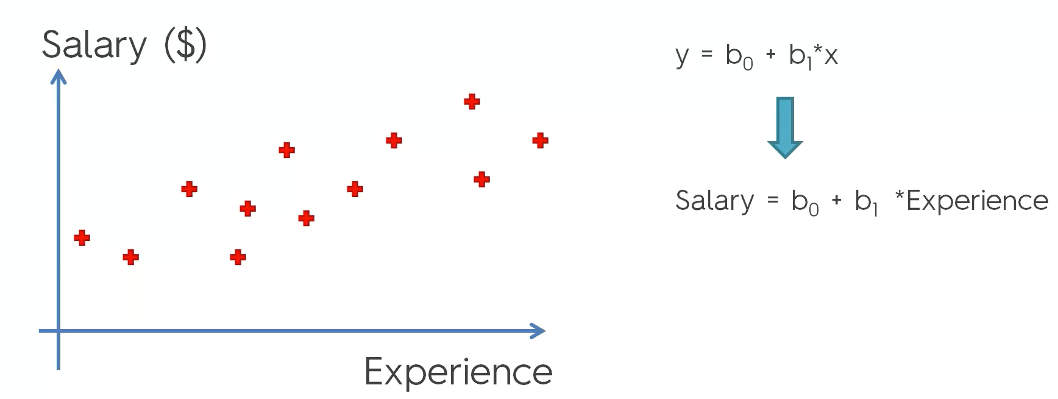
Example
30k

Slide 11
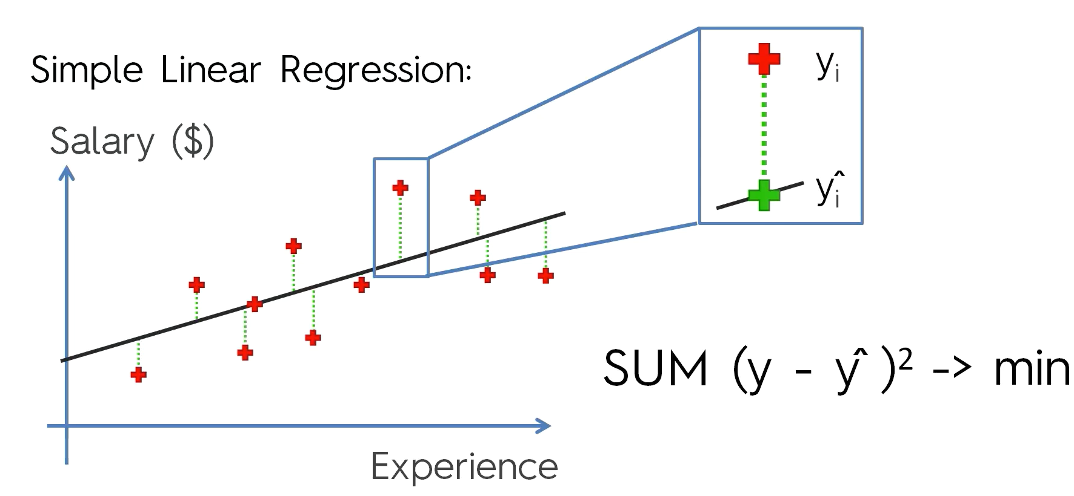
Method of least squares to estimate the best fitting line

Slide 12
Practical Activity

Slide 13
Multiple Linear Regression
Multiple linear regression (MLR), is a statistical technique for predicting the value of a dependent variable, based on the values of two or more independent variables.
The goal of multiple linear regression (MLR) is to model the linear relationship between the independent variable and response dependent variable.

Slide 14
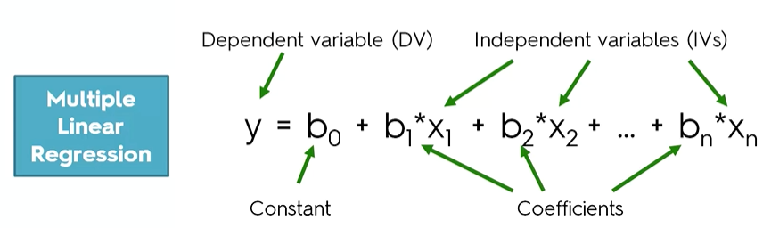
Multiple Linear regression
Straight line regression analysis involves a response variable y and a multiple predictor variable x1…xn and models y is a linear function of x1….xn
where b0 (y-intercept) and b1, b2….bn are the coefficients of the respective independent variable.
These coefficients represent the change in the dependent variable (y) for a one-unit change in the corresponding independent variable
These coefficients can be solved by the method of least squares which estimates the best fitting straight line

Slide 15
Practical Activity

Slide 16
Multiple Linear Regression
Need to chose the variables which are contributing to predict the value for dependent variable
Y
X3
X4
X2
Y
X5
Y
X1

Slide 17


H₀ : Coin is Fair (Null Hypothesis)
H_{a} : Coin is not Fair
0.5
A low p-value (< 0.05) indicates that you can reject the null hypothesis.
0.25
0.12
0.06
0.03

Slide 18
Interpretation of p-Value in the result of liner regression
The p-value for each term tests the null hypothesis that the coefficient is equal to zero( independent variable has less importance)
A low p-value (< 0.05) indicates that you can reject the null hypothesis
A predictor(Independent Variable) that has a low p-value is likely to be a meaningful addition to your model because changes in the predictor's value are related to changes in the response variable.
Conversely, a larger (insignificant) p-value suggests that changes in the predictor are not associated with changes in the

Slide 19
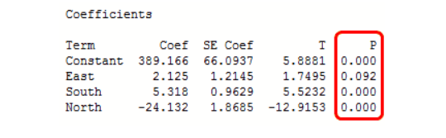
Interpretation of p-Value in the result of liner regression
We use the coefficient p-values to determine which terms to keep in the regression model. In the model above, we should consider removing East.

Slide 20
There are essentially five methods of building a multiple linear regression model.
Use Everything In and Hope for the Best
Consider all the attributes (Independent variables) for building model
Backward Elimination
Step 1: Select a significance level to stay in the model (ex . 0.05)
Step 2 : Fit the full model with all possible predictors
Step 3 : Consider the predictor with the highest p-value . If P> SL , go to step 4 , otherwise go to finish
Step 4 : Remove the predictor
Step 5 : Fit the model without this variable
There are essentially five methods of building a multiple linear regression model.
Chuck Everything In and Hope for the Best
Backward Elimination
Forward Selection
Bidirectional Elimination
Score Comparison

Slide 21
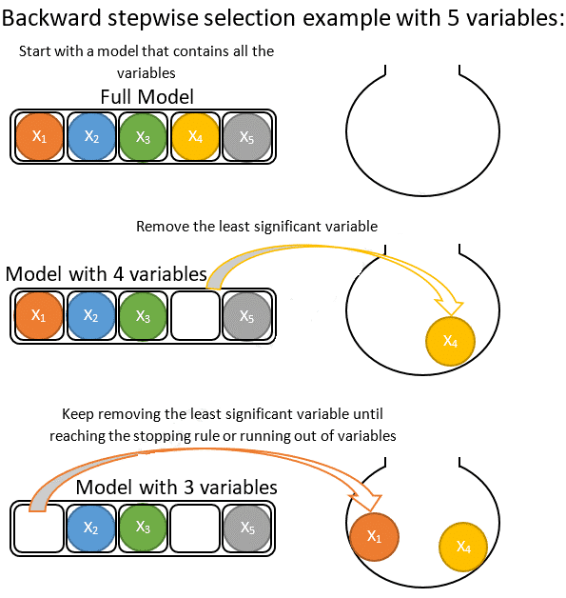

Slide 22
Forward Selection
Step 1: Select a significance level to stay in the model (ex . 0.05)
Step 2 : Fit all simple regression models y-X_{n} select the one with lowest P-value
Step 3 : Keep this variable and fit all possible models with one extra predictor added to one(s) you already have
Step 4 : Consider the predictor with the lowest P-value .If P<SL , go to step 3,otherwise go to FIN and keep the previous model
There are essentially five methods of building a multiple linear regression model.
Chuck Everything In and Hope for the Best
Backward Elimination
Forward Selection
Bidirectional Elimination
Score Comparison

Slide 23
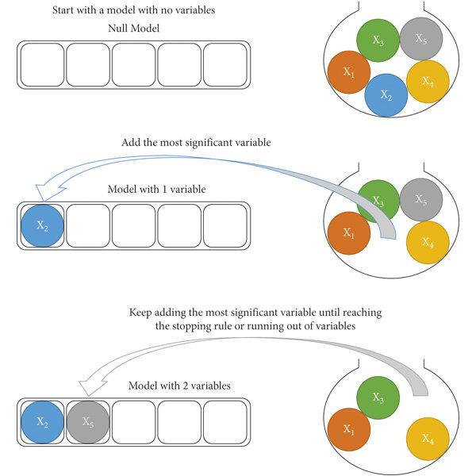
There are essentially five methods of building a multiple linear regression model.
Chuck Everything In and Hope for the Best
Backward Elimination
Forward Selection
Bidirectional Elimination
Score Comparison

Slide 24
Bidirectional Elimination
Step 1: Select a significance level to enter and stay in the model (ex . Enter=0.05,stay=0.05)
Step 2 : Perform the next step of forward selection (new variables must have P<Enter to enter)
Step 3 : Perform ALL steps of backward elimination (old variables must have p<stay to stay)
Step 4 : Now new variable can enter and no old variables can exit , then model is ready
There are essentially five methods of building a multiple linear regression model.
Chuck Everything In and Hope for the Best
Backward Elimination
Forward Selection
Bidirectional Elimination
Score Comparison

Slide 25
Score Comparison
Step 1: Select a criterion of goodness of fit
Step 2: Construct all possible regression Models 2^{N} – 1 total combinations
Step 3 : Select the one with the best criterion
There are essentially five methods of building a multiple linear regression model.
Chuck Everything In and Hope for the Best
Backward Elimination
Forward Selection
Bidirectional Elimination
Score Comparison

Slide 26
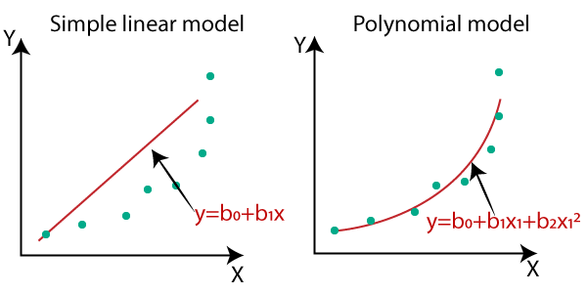
Polynomial Regression

Slide 27
Polynomial Regression
The polynomial models can be used in those situations where the relationship between study and explanatory variables is curvilinear
If your data points clearly will not fit a linear regression (a straight line through all data points), it might be ideal for polynomial regression.
Polynomial regression, like linear regression, uses the relationship between the variables x and y to find the best way to draw a line through the data points.

Slide 28
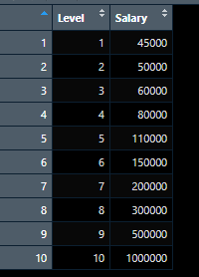
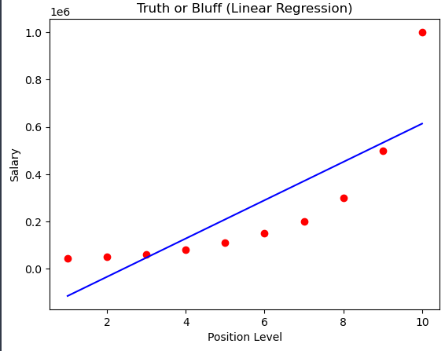
polynomial regression?
linear regression model

Slide 29
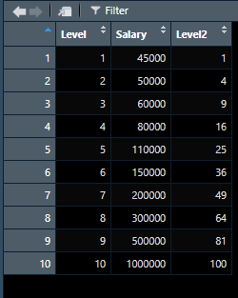
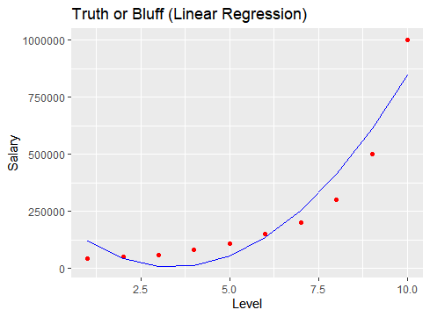
Level 2 = Level ^ 2 (add powers of the original features as new features.)
regression model

Slide 30
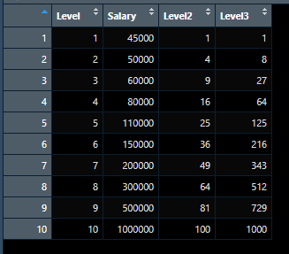
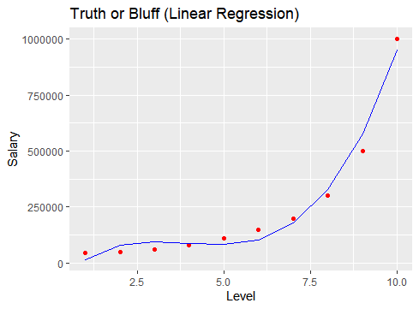
Level 3 = Level ^ 3 (add powers of the original features as new features.)
regression model

Slide 31
In the plot of the best fit line is, we can see that the straight line is unable to capture the patterns in the data.
To overcome under-fitting, we need to increase the complexity of the model.
To generate a higher order equation we can add powers of the original features as new features.
Linear regressor for given example is
Independent Variable(Feature)
salary= b0+b1*Level ^1+b2*Level^2+b3*Level*3
Dependent Variable

Slide 32
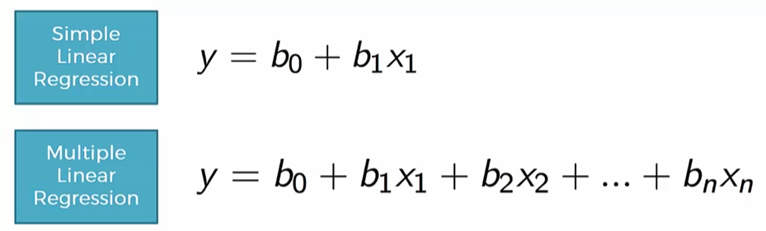
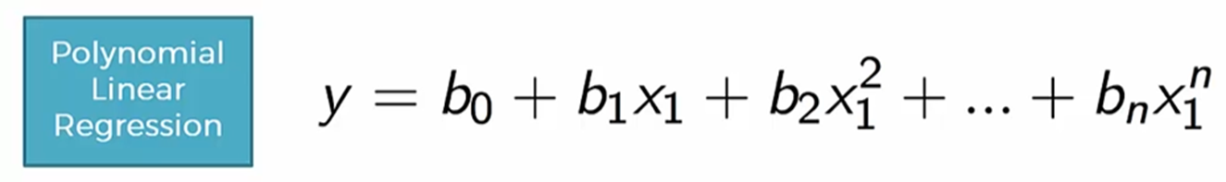
Polynomial Regression

Slide 33
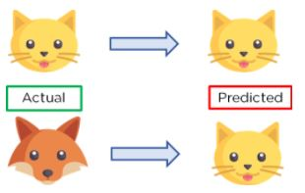
Variance
variance is an algorithm’s flexibility to learn patterns in the observed data.
Variance is the amount that an algorithm will change if a different dataset is used.
A model is of high variance when, for instance, it tries too hard that it not only captures the pattern of meaningful features but also that the meaningless error (overfitting).

Slide 34
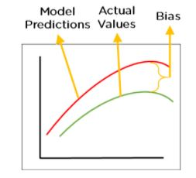
Bias
Bias is measured by the differences between the expected predicted values and the observed values
Bias is the simple assumptions that our model makes about our data to be able to predict new data.
When the Bias is high, assumptions made by our model are too basic, the model can’t capture the important features of our data.
This means that our model hasn’t captured patterns in the training data and hence cannot perform well on the testing data too. If this is the case, our model cannot perform on new data and cannot be sent into production.

Slide 35
Uderfitting
When a model is unable to capture the essence of the training data properly because of a low number of parameters then this phenomenon is known as Underfitting
High bias error, Low variance error, high error rate in the training data
Very less amount of data to build the model
Since our model performs badly on the training data, it consequently performs badly on the testing data as well.

Slide 36
Overfitting
When a model is built using so many predictors that it captures noise along with the underlying pattern
It tries to fit the model too closely to the training data leaving very less scope for generalizability. This phenomenon is known as Overfitting.
Low bias error, High variance error
When the model has a low error rate in training data but a high error rate in testing data, we can say the model is overfitting the training data set
This usually happens when hyperparameters have been tuned to produce a low error rate on the training data.
Notes:
Think of a student who studied a certain set of questions and then gave a mock exam which contains those exact questions they studied. They might do well on the mock exam but on the real exam, which contains unseen questions, they might not necessarily do well. If the student gets a 95% in the mock exam but a 50% in the real exam, we can call it overfitting.

Slide 37
Multicollinearity
Multicollinearity exists when:
One independent variable is correlated with another independent variable.
One independent variable is correlated with a linear combination of two or more independent variables.
Independent variable
Y= b0+b1 * X1 + b2 * X2 + b3 *X3 + penalty
Total exp industry exp + teaching exp

Slide 38
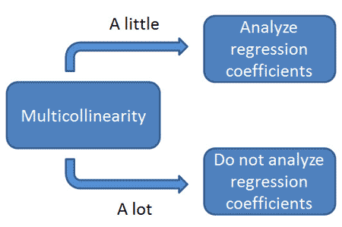
The Multicollinearity Problem
As part of regression analysis, researchers examine regression coefficients to assess the relative influence of independent variables on the dependent variable
When independent variables show multicollinearity, there will be problems figuring out the specific variable that contributes to the variance in the dependent variable.

Slide 39
Multicollinearity makes it hard to assess the relative importance of independent variables, but it does not affect the usefulness of the regression equation for prediction. Even when multicollinearity is great, the least-squares regression equation can be highly predictive. So, if you are only interested in prediction, multicollinearity is not a problem.

Slide 40
Ridge Regression
When multicollinearity occurs, least squares estimates are unbiased, but their variances are large so they may be far from the true value.
Ridge regression adds a penalty term to the linear regression cost function to prevent overfitting and reduce the impact of multicollinearity.
Ridge regression looks at all independent variables and it tries to adjust the coefficients to make good predictions while also keeping them for getting too large
By adding a degree of bias to the regression estimates, ridge regression reduces the standard errors by keeping less values of coefficient of independent variables and avoids overfitting

Slide 41
Ridge Regression
Equation of ridge regression is
Y = β₀ + β₁ * X₁ + β₂ * X₂ + β3 * X3 + penalty

Slide 42
Lasso(Least Absolute Shrinkage and Selection Operator) Regression
It is a linear regression technique used for feature selection : In case of many independent variables, it selects a subset of the most important features and sets the coefficients of less important features to zero.
LASSO regression is also used for overfitting prevention, it reduces the standard errors by keeping less values of coefficient of independent variables and avoids overfitting

Slide 43
Lasso Regression equation
Equation of Lasso regression is
y = β0 + β1x1 + β2x2 + ... + βnxn + λΣ|βi|
In above equation the extra lasso term added is λΣ|βi| , λ (lambda) is a positive number that we choose beforehand. It controls how much we want to push some coefficients towards zero. The larger λ is, the more coefficients will be forced to become zero.

Slide 44
Lasso Regression decides which predictors are not important by analyzing the data during training process
Assign initial coefficients : Lasso starts with some initial coefficients for each predictor, just like regular linear regression. These coefficients represent the initial belief about how important each predictor is.
Adjusting Coefficients: Lasso then tries to adjust these coefficients to fit the data. It does this by minimizing the following equation:
Loss Function = (Sum of Squared Residuals) + λΣ|βi|
1. The "Sum of Squared Residuals" part measures how well the model fits the actual data points, it is difference between expected output and actual output
2. The "λΣ|βi|" part is the regularization term. It penalizes the coefficients (βi) for being too large. This is where the magic happens.

Slide 45
Shrinking Coefficients Toward Zero: The regularization term (λΣ|βi|)pushes some coefficients to become exactly zero.
Choosing Important Predictors: Lasso decides which predictors are not important by looking at which coefficients become zero.
Selecting a Suitable Lambda (λ): The λ value controls the strength of the penalty term. If you choose a larger λ, it will be more likely that more coefficients become zero, leading to a simpler model with fewer predictors. If you choose a smaller λ, fewer coefficients may become zero, and more predictors will be retained in the model.
Y = b0 + b1 *x1+ b2 *x2 + penalty
10 5 o
5 3 7
3 0 12

Slide 46
Revise
Explain simple linear regression model using suitable example
Explain multiple linear regression model using suitable example
Explain polynomial regression model using suitable example
Explain the terms bias, variance ,overfitting and underfitting
Explain the need of ridge regression. State and explain equation of ridge regression
Explain the need of lasso regression. Sate and explain equation of lasso regression
Explain how Lasso Regression decides which predictors are not important for prediction of target variable

